Slide 1
Draft Food Safety and Standards Proposed (Labelling & Display) Regulations – An overview
Kumar Anil
Advisor (Standards), FSSAI
Email: advisor@fssai.gov.in

Slide 2
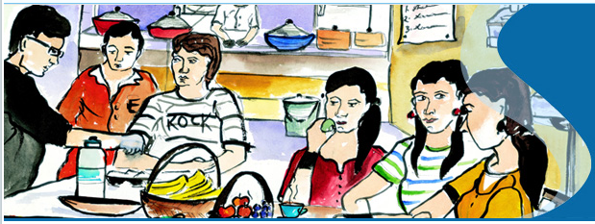
OBJECTIVE
The Food Safety and Standards Authority of India (FSSAI) has been created for laying down science based standards for articles of food and to regulate their manufacture, storage, distribution, sale and import to ensure availability of safe and wholesome food for human consumption.

Slide 3
Food Safety and Standards (Packaging and Labelling) Regulations, 2011
Food Safety and Standards Authority of India (FSSAI) has undertaken revision of existing (Packaging and Labelling) Regulations, 2011 and it has been split into three separate regulations as under:
Draft Packaging Regulations.
Draft Advertisement and Claims Regulations.
Draft Labelling Regulations.

Slide 4
Salient features of the proposed labelling regulation
Aimed at establishing requirements for labelling of pre-packaged foods to provide simple, easy to understand information to consumers and facilitate them in making healthier food choices.
Defines general and specific labelling requirements including declaration of:
Name
Ingredient list
Nutritional information
Declaration reg. veg, non-veg
Food additives
Name and complete address of manufacturers
FSSAI logo and license no.
Date marking
Lot no./Batch No.
Net quantity
Instructions for use
Country of origin.

Slide 5
Cont...
Prescribes requirements for Front of pack labelling which includes labelling of energy, total fat, trans fat, total sugar and salt on FOP along with their % contribution to RDA and HFSS labelling.
Mandatory declarations including statutory warnings, specific labelling for:
Infant foods
Milk & milk products
Edible oil and fat products
Irradiated foods
Fortified foods
Organic foods
Low gluten and gluten free foods
Genetically engineered or modified foods
Alcoholic Beverages.
Labelling of Non-retail containers.

Slide 6
Changes & new inclusions in the proposed labelling regulations -
Nutritional Information (back of pack)
Mandatory declaration of the following:
Saturated fat (g), trans fat (g) and cholesterol (mg)
Salt (sodium chloride)(g)
Per serve percent (%) contribution of nutrients to Recommended Dietary Allowance (RDA).
Number of servings per pack and serving size.

Slide 7
Nutritional Information Panel
No. of servings
Serving size:
No. of servings:
Energy (kcal) | Per 100 g or 100ml | % RDA per serve
Protein (g)
Carbohydrate (g)
Sugars (g)
Total fat (g)
Saturated fat (g)
Trans fat (g)
Cholesterol (mg)
Salt (g)
Micronutrients (minerals and vitamins)

Slide 8
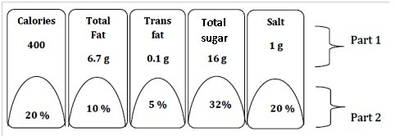
Front of Pack (FOP) Labelling
Mandatory declaration of Energy, total fat, trans fat, total sugar and salt along with their percent (%) contribution to RDA on the front of pack label:
Part 1: Amounts of Energy, total fat, trans fat, total sugar and salt per serve
Part 2: Per serve percentage (%) contribution to RDA
Calculation Criteria for per serve percentage (%) contribution to RDA based on 2000 kcal energy, 67 g total fat, 2 g trans fat, 50 g sugar and 5 g salt (sodium chloride) requirement for average adult per day

Slide 9
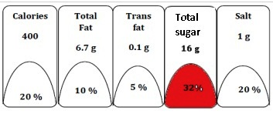
Front of Pack labelling of HFSS Foods
“High Fat, Sugar and Salt” food shall be coloured ‘RED’ if:
Energy (kcal) from total sugar is more than 10% of energy provided by the 100g/100ml of the product;
Energy (kcal) from trans fat is more than 1% of energy provided by the 100g/100ml of the product;
Total fat and sodium content: more than the threshold values as specified in Schedule - I.
‘No depiction’ of block for the above said Nutrient/Nutrients is required, if the nutrient is absent in the product.

Slide 10
Allergen Information
Label declaration of ingredients known to cause allergy including:
Cereals containing gluten; i.e., wheat, rye, barley, oats, spelt or their hybridized strains and products of these
Crustacean and their products
Milk & Milk products
Eggs and egg products
Fish and fish products
Peanuts, tree nuts and their products
Soybeans and their products
Sulphite in concentration of maximum 10mg/kg

Slide 11
Declaration regarding Veg, Non-Veg and Food not meant for human consumption
Every package of food containing ingredients including food additives, processing aids of animal origin shall consist of a brown colour filled circle inside a square as indicated below :
Every package of food containing ingredients including food additives, processing aids of plant origin shall consist of a green colour filled triangle inside a square as indicated below:
Every package of food material which is not meant for human consumption shall bear a declaration to this effect by a symbol as stipulated below:

Slide 12
Date Marking
(a) Mandatory declaration of Expiry date instead of “Best Before date” as presently practiced.
(b) “Date of manufacture or packaging” and “Expiry /Use by date” shall be grouped together and given at one place.
(a) Name of the food;
(b) Net Quantity;
(c) FSSAI Logo and License number;
(d) Date marking;
(e) Lot No.
And every package meant for non- retail sale shall bear a statement “NOT FOR RETAIL SALE”
Non-retail containers shall declare on the container or label attached thereto:

Slide 13
Prepared food served for immediate consumption such as in restaurants or food services shall accompany the minimum information as specified at point of sale or service which includes:
(a) any warning/statutory declarations required under these regulation;
(b) information relating to allergen; and
(c) logo for veg or non-veg
(d) FBOs falling under state or central license shall keep nutritional information of food items served by them in the form of booklet which shall be provided to consumers upon request.

Slide 14
Fortification Logo
Organic Food Logo

Slide 15
Proposed Labelling for Alcoholic Beverages
Statutory Warning to be given in English Language as given below:
In case, respective states wish the same to be printed in their local or regional language, the same shall be allowed, without the need for repeating the English version. Size of statutory warning shall not be less than 3 mm.
CONSUMPTION OF ALCOHOL IS INJURIOUS TO HEALTH.
BE SAFE “DON’T DRINK AND DRIVE”

